Slide 1
Design Pattern Examples
C-FORS Summer School, University of Oslo

Slide 2
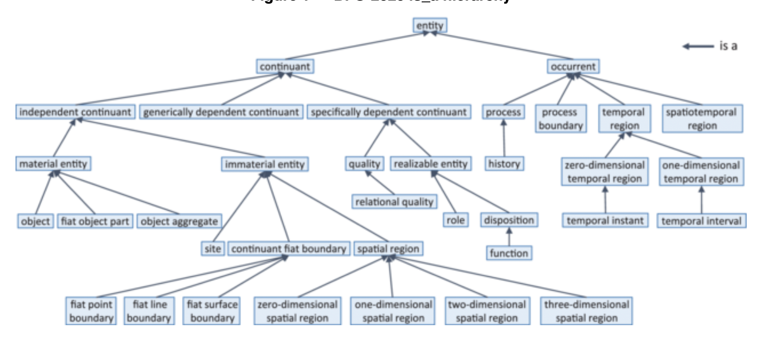

Slide 3
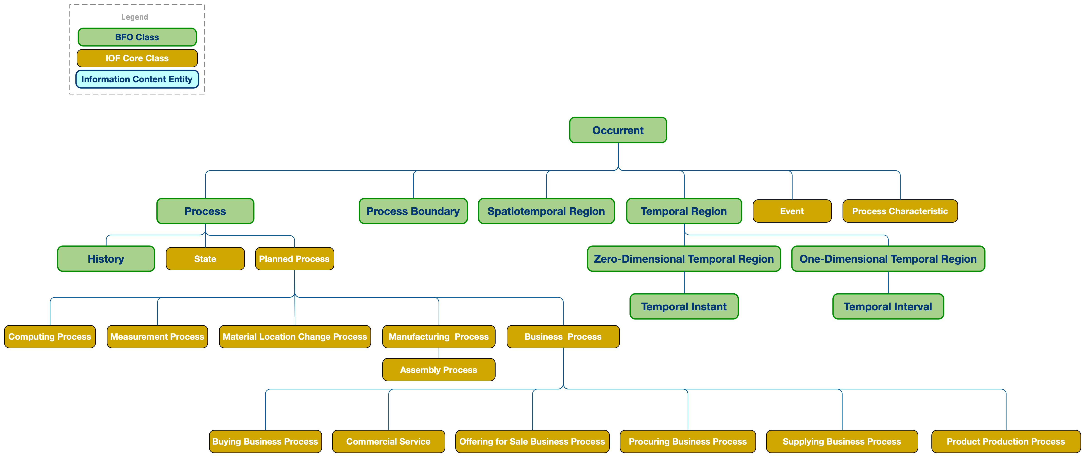
IOF Core: Entities Existing Over Time

Slide 4
IOF Core: Entities with Material Parts

Slide 5
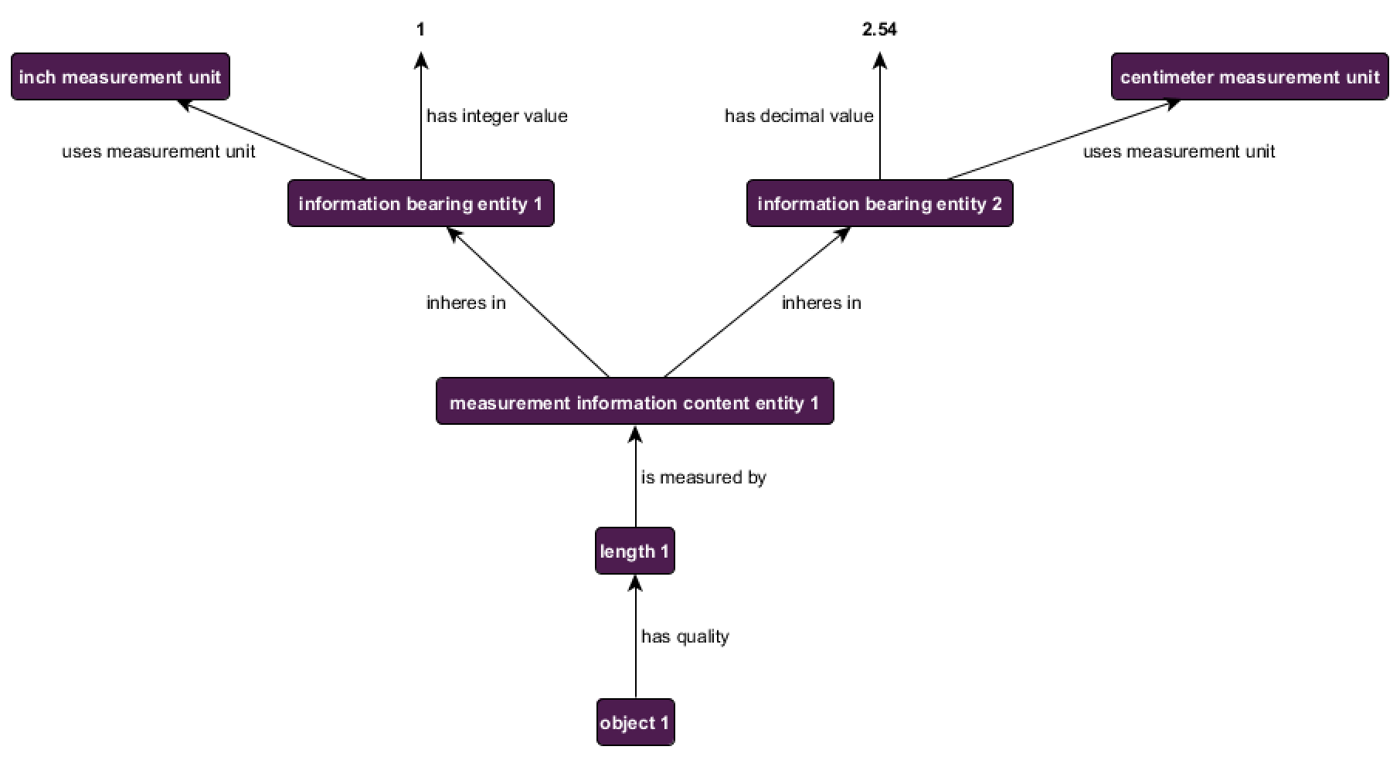
CCO Measurement

Slide 6
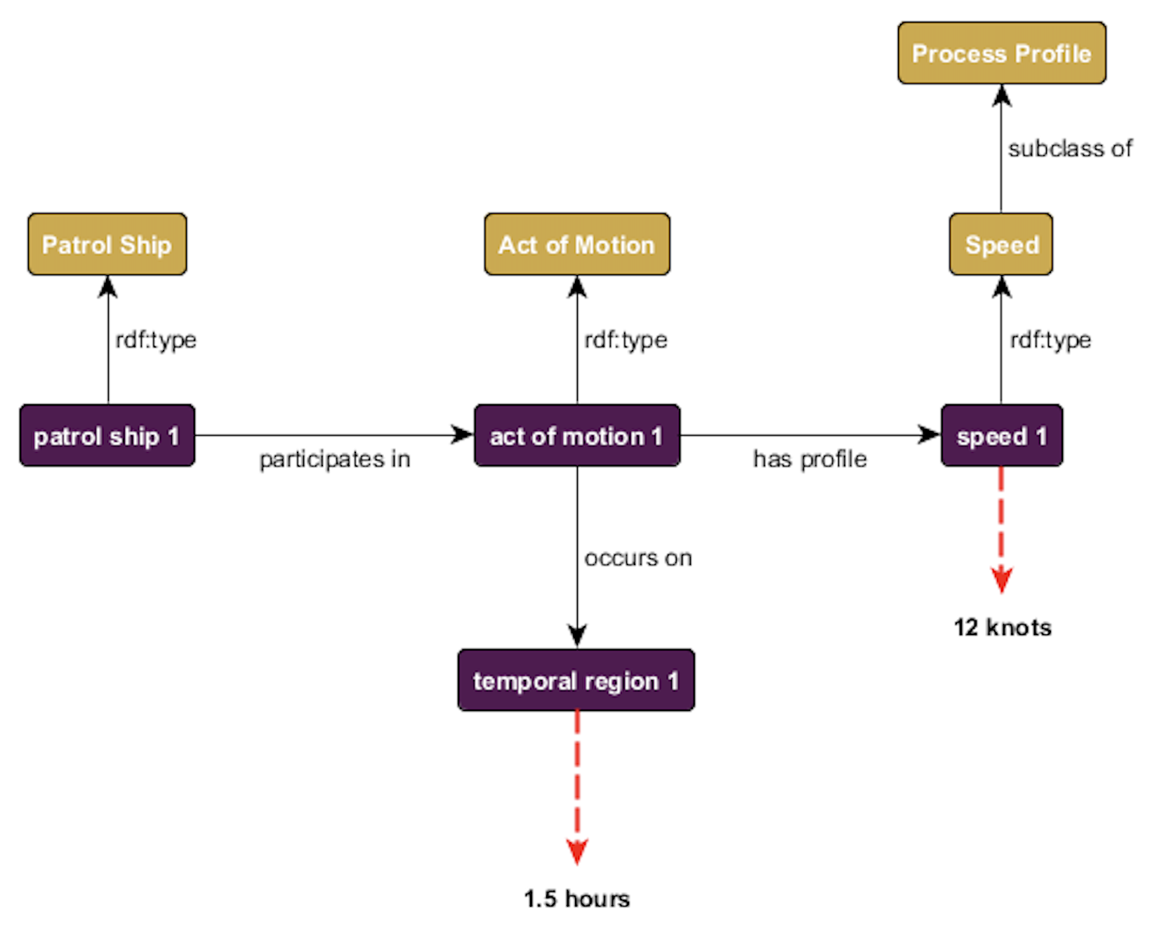
Common Core Ontologies
Design Pattern representing
a patrol ship traveling 12 knots
over 1.5 hours

Slide 7
Representing Drone Motion
*Classes not diagramed due to space constraints
decimal
drone
has lat value
geographic part 2
has alt value
decimal
participates in
has geo extent
motion process
spatio temporal region
spatio temporal part 2
has lon value
has part
decimal
occupies spatiotemporal region
temporal interval 2
has profile
has interval extent
has date value
has part
date
speed
spatio temporal part 1
has geo extent
geographic part 1
has lon value
decimal
speed value
has alt value
Instance
has interval extent
decimal
decimal
has lat value
temporal interval 1
has date value
date
Value
decimal
KEY

